Slide 1

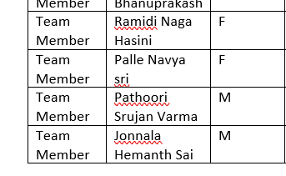
SMART INDIA HACKATHON 2026
Problem Statement ID –SIH26047
ProblemStatement Title-Patient Case-Taking Software
Theme-MedTech/BioTech/ HealthTech
PS Category- Software
Team ID-181644
Team Name - Prism

Slide 2
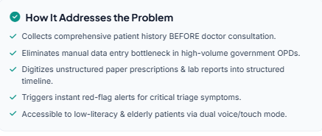
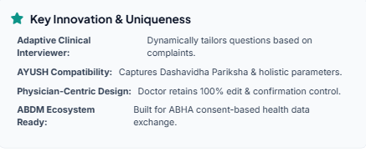
MediKiosk-Smart Patient Care & Assistance
Prism
MediKiosk acts as an intelligent pre-consultation assistant. Patients interact via touchscreen or voice in regional Indian languages. The system asks adaptive clinical questions, scans old paper prescriptions via OCR, extracts medical entities into a chronological timeline, and flags red-flag symptoms for triage—delivering a physician-ready clinical summary before the patient walks in.
MediKiosk
AI History Taking ,Voice + Touch
OCR + Timeline ,Red-Flag Detection
PATIENT
Doctor
Medikiosk fills the first-mile gap between the patient and doctor.

Slide 3
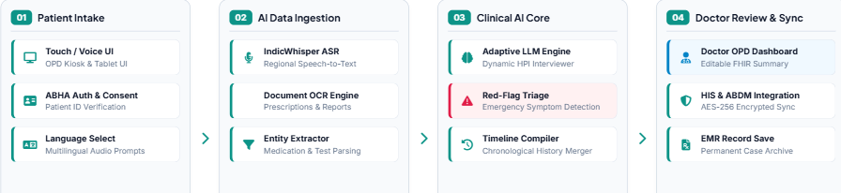
TECHNICAL APPROACH
Prism
Our architecture pairs a responsive React/Next.js frontend with Python FastAPI backend. We leverage multilingual speech recognition, LLM-based adaptive questioning, and medical OCR for document parsing. Data is structured using FHIR-compatible formats, with planned ABHA/ABDM integration through appropriate consent mechanisms.

Slide 4
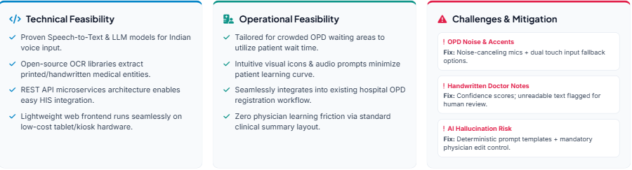
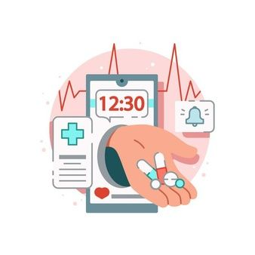
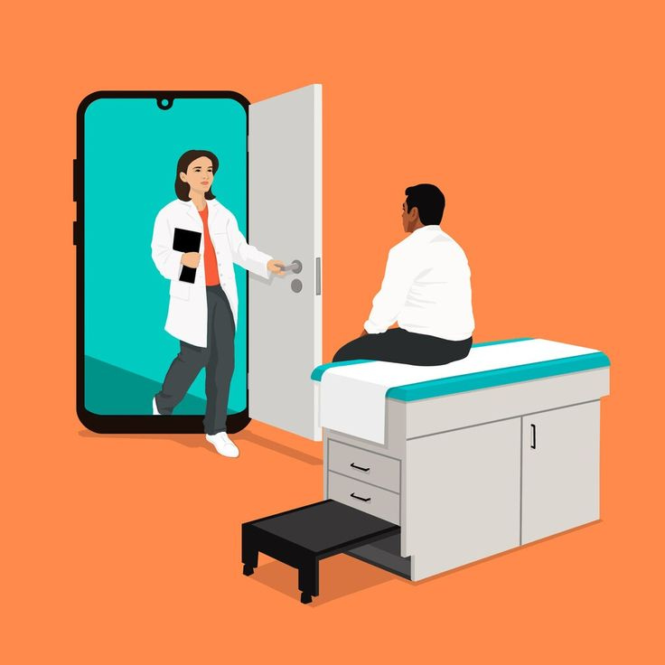
FEASIBILITY AND VIABILITY
Prism
Human-in-the-loop design ensures that AI-generated information is reviewed by the physician before clinical use.

Slide 5
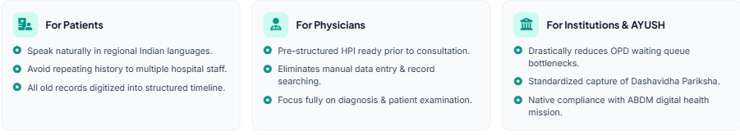
IMPACT AND BENEFITS
Prism
Patients gain accessible, multilingual intake without repeating their story. Doctors save up to 50% of manual data collection time, allowing more time for physical examination and clinical decision-making. Hospitals gain organized digital records and faster OPD flow, supporting standard medicine as well as AYUSH Dashavidha Pariksha.
Potentially reduces manual history-taking time; effectiveness will be validated through prototype testing.

Slide 6
RESEARCH AND REFERENCES
Prism
• World Health Organization (WHO) – Global strategy on digital health
• Ayushman Bharat Digital Mission (ABDM) – Digital health ecosystem and health-data exchange framework.
• Ministry of Health & Family Welfare, Government of India – Digital health initiatives.
• Electronic Health Record (EHR) / patient registration workflows – used as design reference for structured intake.
•Human-centered design principles – accessible interfaces, multilingual prompts and minimal-step workflows.

